Slide 1
Design Distributed Notification System

Slide 2
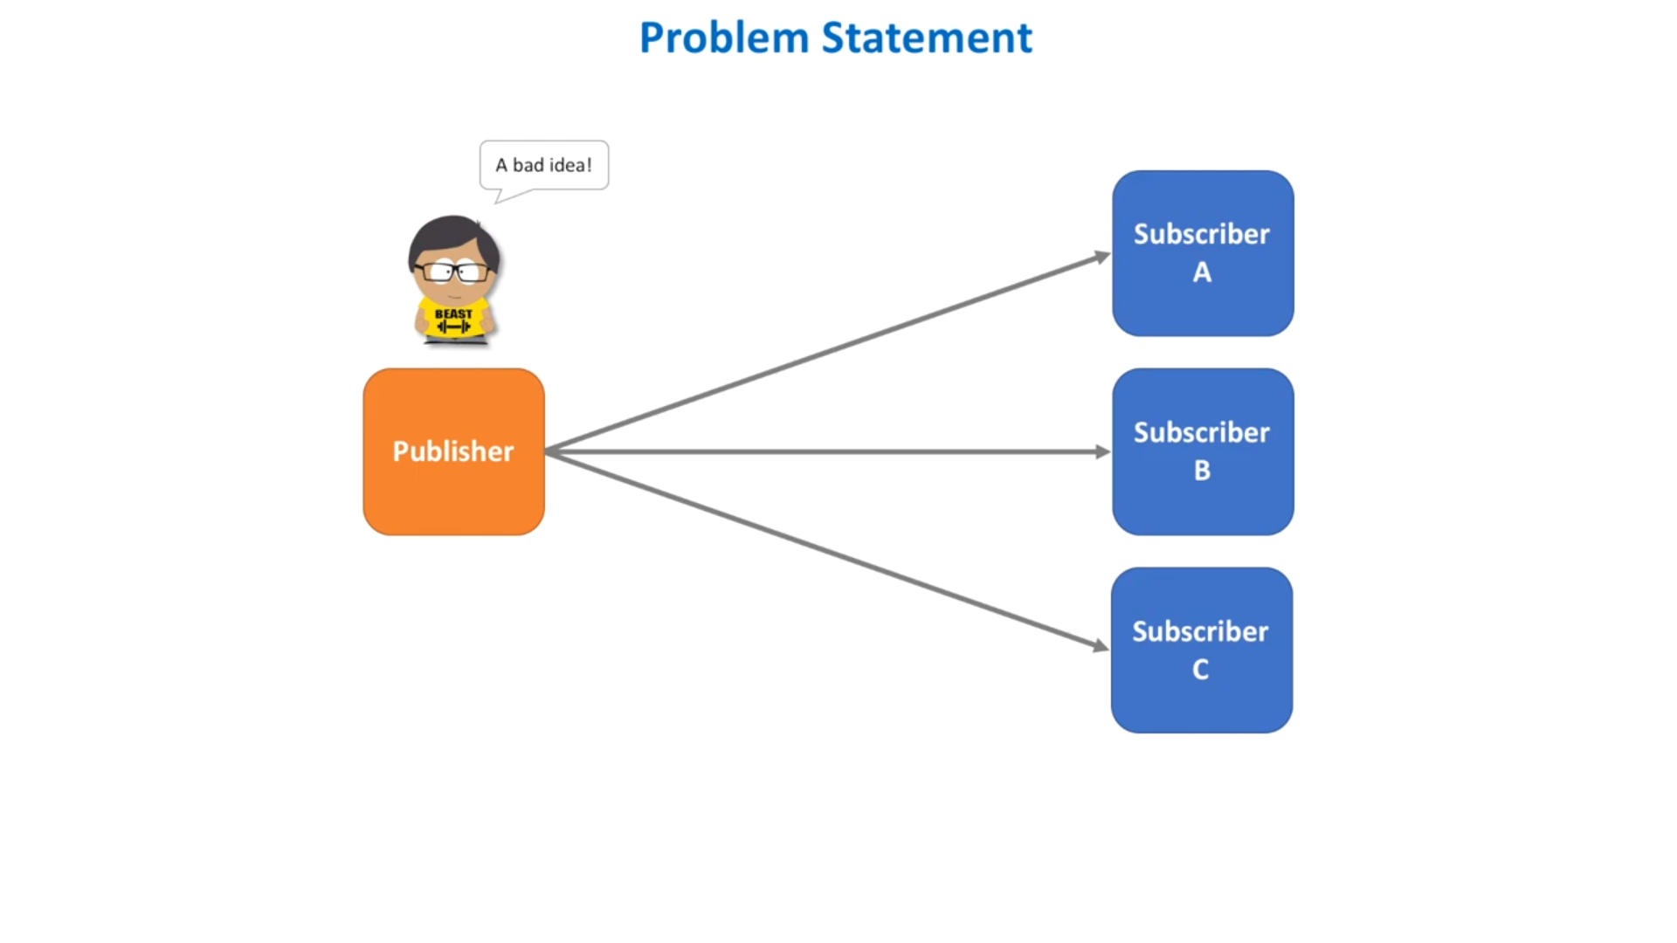

Slide 3
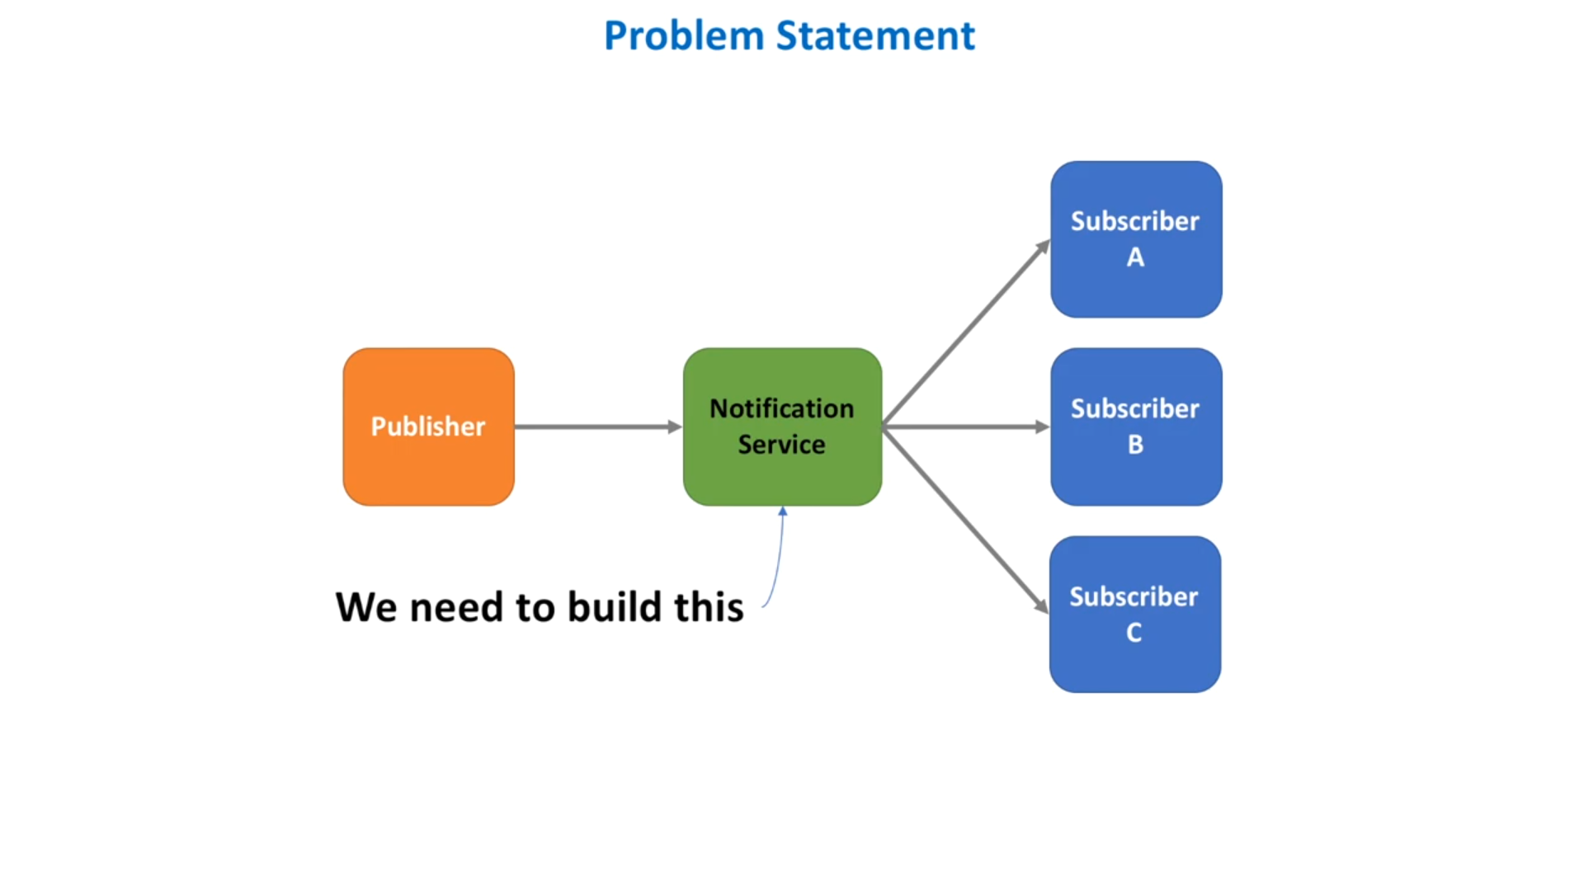

Slide 4
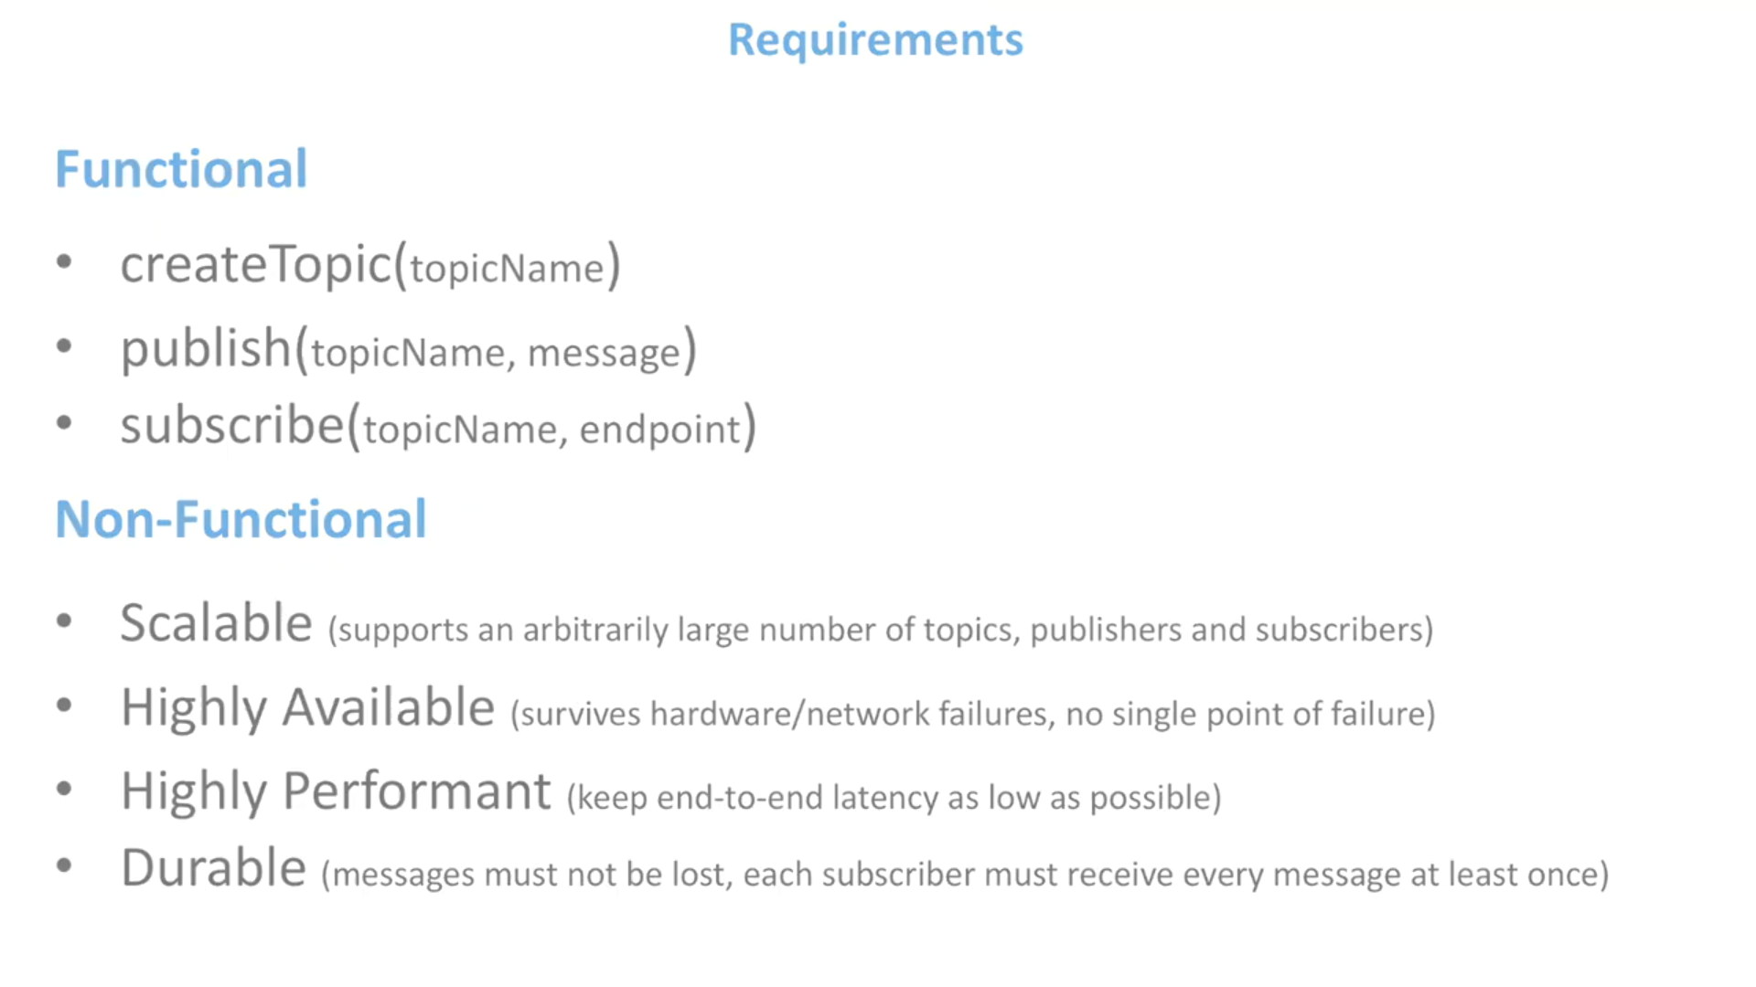

Topic is like a bucket. Where the producer will store the messages and the subscribers will retrieve the messages from the buckets

Slide 5
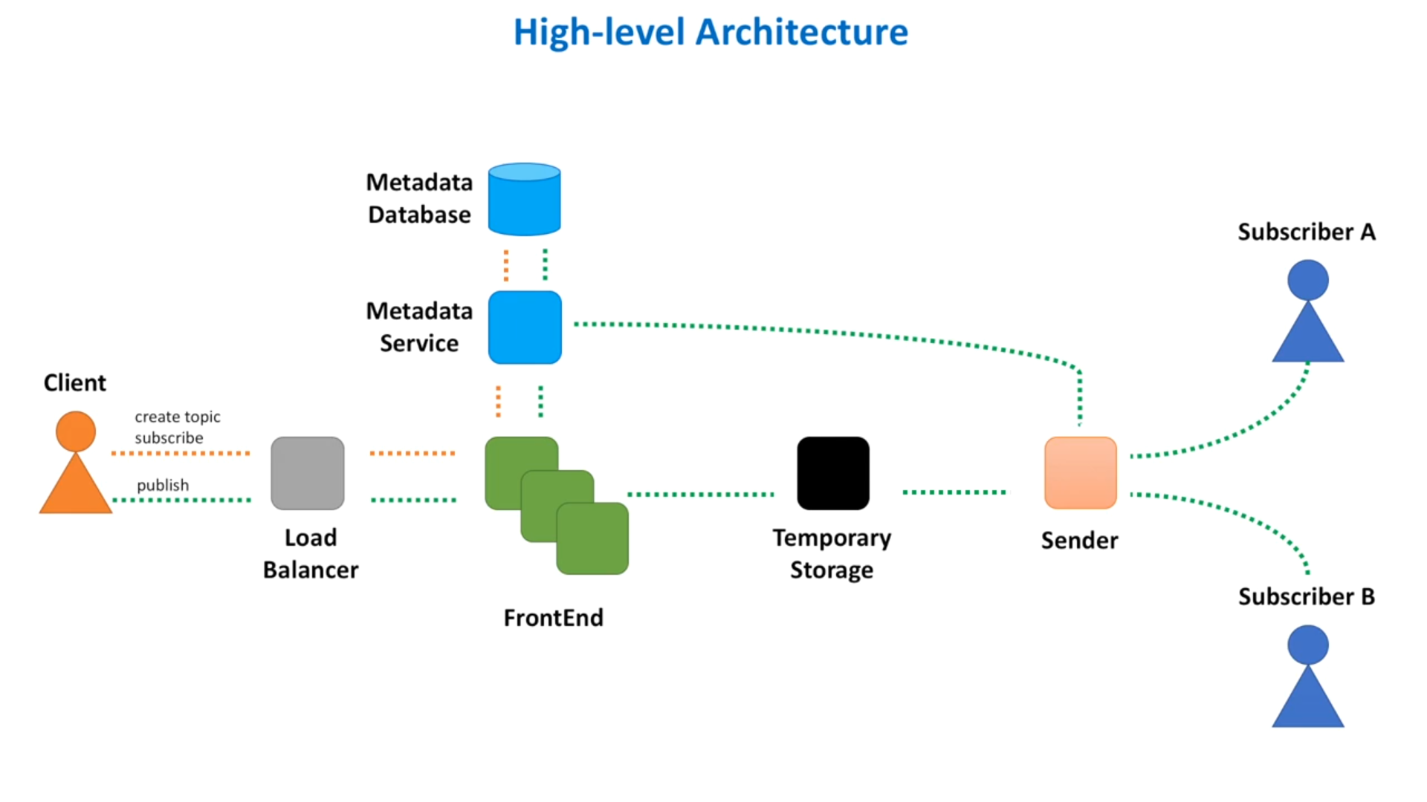
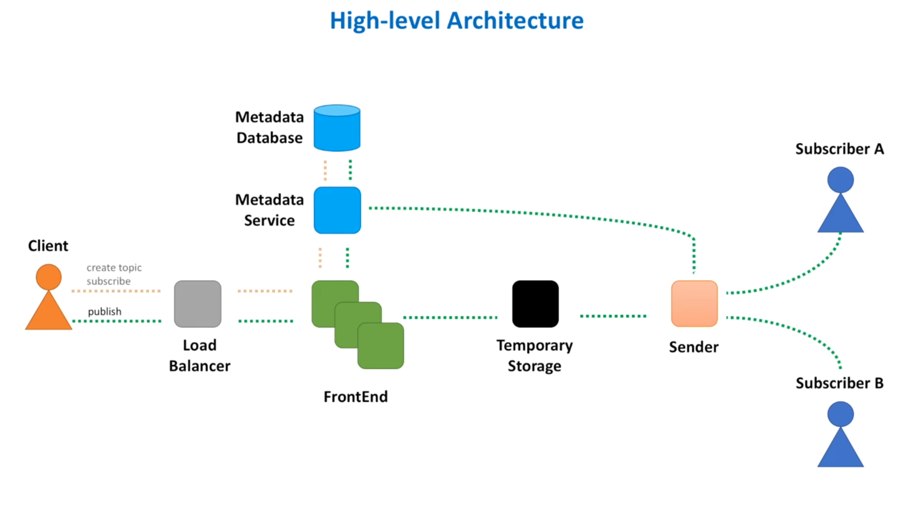

Slide 6
Requests go throught a load balancer first. This ensures the request loads are evenly distributed among the app servers.
The load balancer forwards the request to frontend service. The front end service uses metadata service to fetch the details of the topics and subscriptions stored in metadata db.
We need to store the messages for some period of time until all subscribers are available and message is sent to them. Hence we need a temporary storage.
Last we need a sender that retrieves the messages from temp store and sends them to the subscibers. Sender calls the metadata service to get the subscriber list associated with this topic.

Slide 7
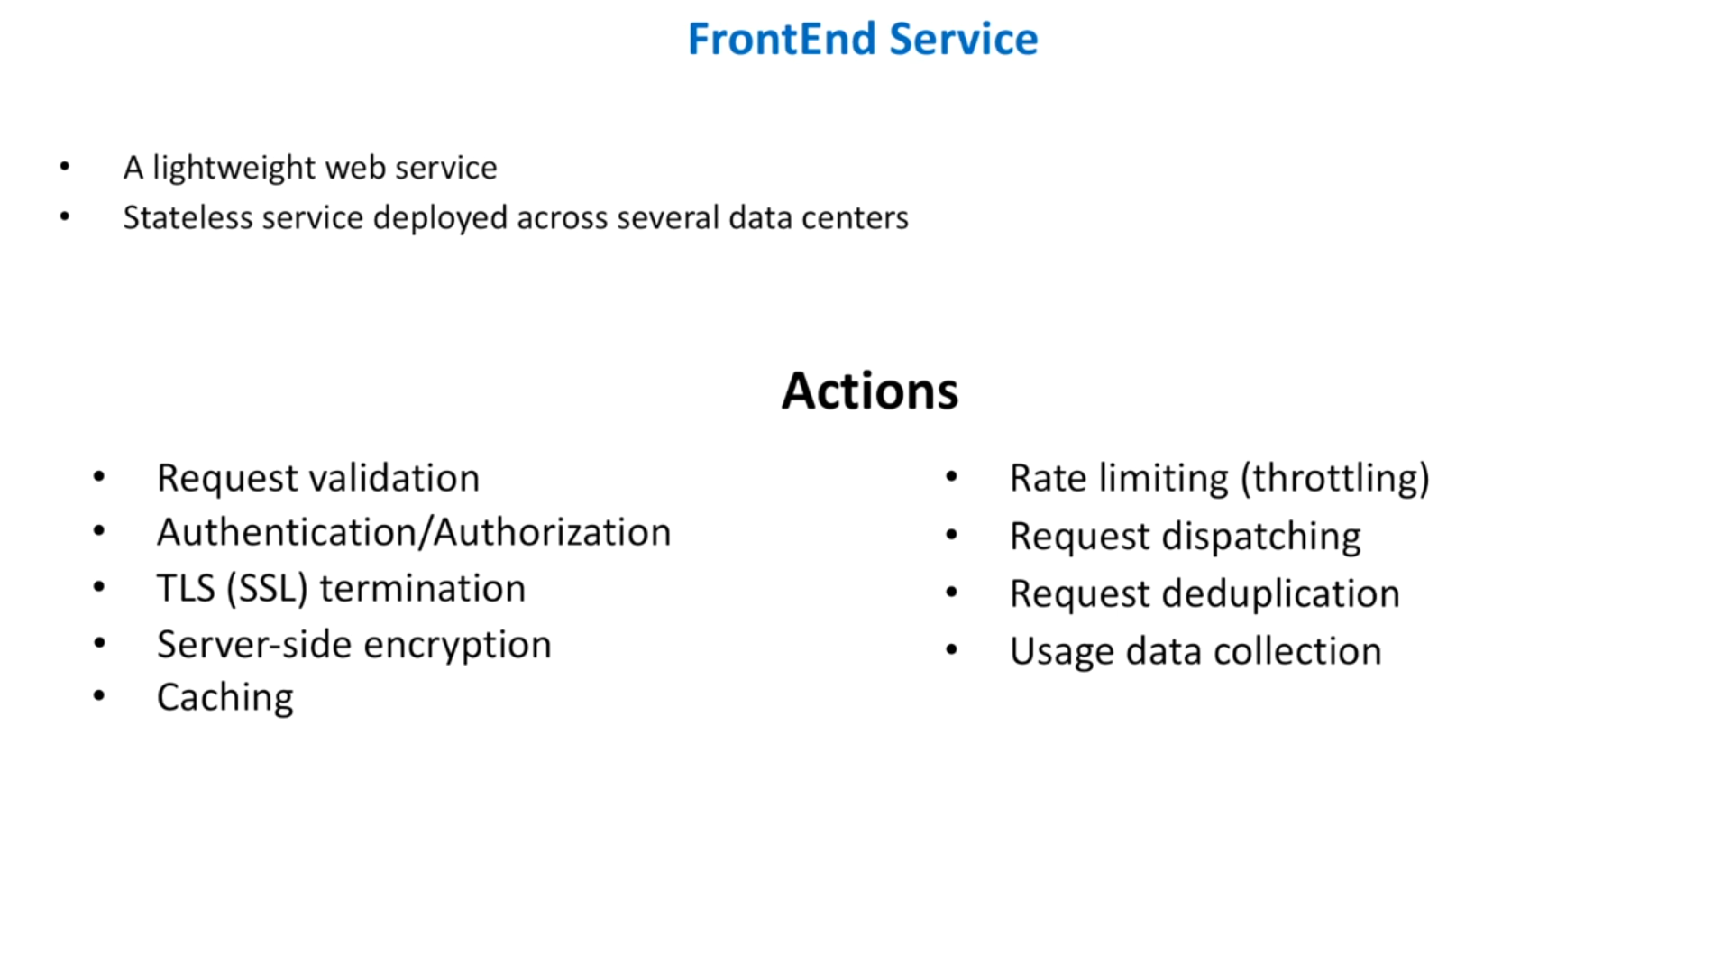

Slide 8
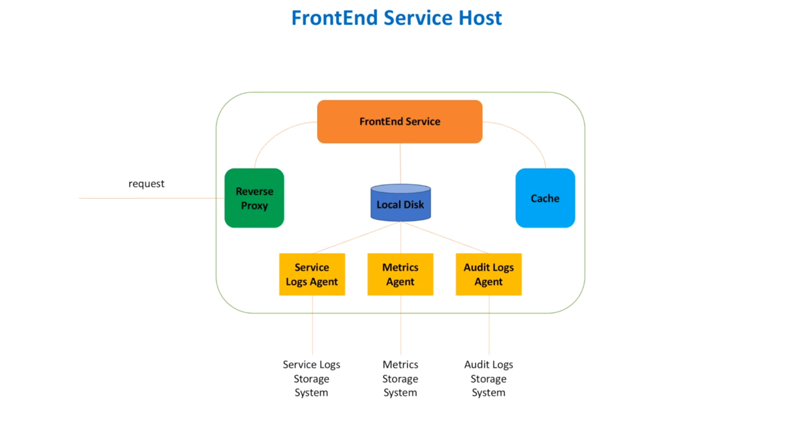

Slide 9
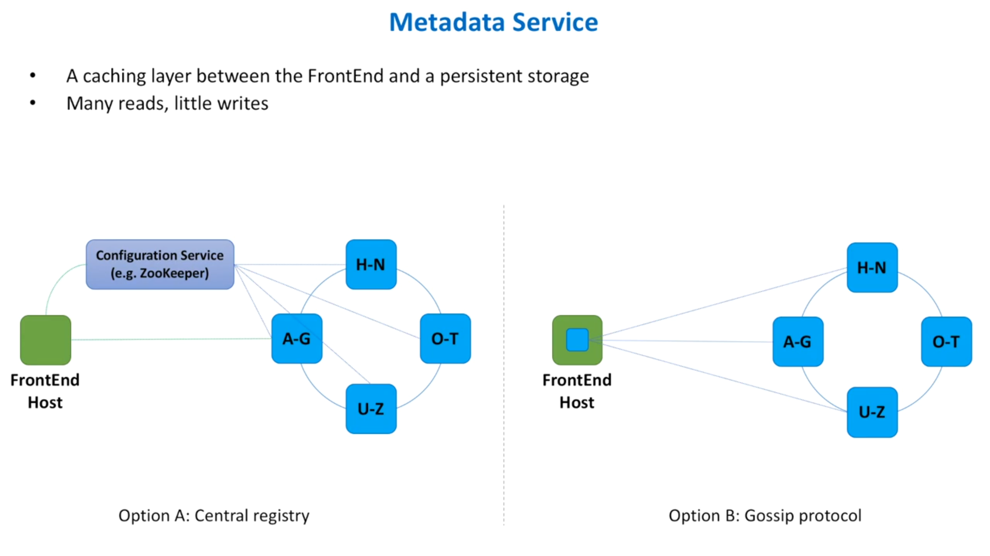

Slide 10
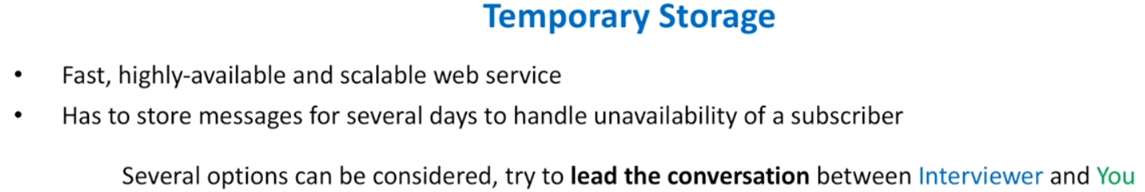
Option 1: Database
  We dont need ACID transactions
  We dont need to run complex queries
  We donot want to use the storage for data analytics and warehousing.
  We need a db that is scalable, highly available and tolerate network partitions.
  So SQL or NoSQL? - ans: above requirements are met by NoSQL.
  Type of NoSQL?
    Messages have a limited size like 1MB. So we donot need a document store.
    There is no specific relationship between messages. So we donot need graph dbs
    So we can use either column or key - value dbs.
      Ex - Apache Cassandra, Amazon DynamoDb

Slide 11
Option 2: InMemory Caching
  We can use in-memory datastores as long as they support persistence.
  Ex - Redis
Option 3: Message Queues
  Distributed message queues have all the characteristics we need.
  Example - Apache Kafka, Amazon SQS.

Slide 12
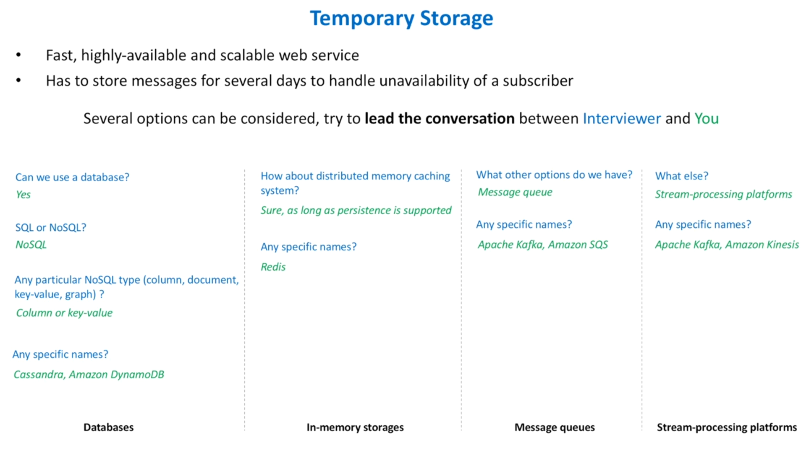

Slide 13
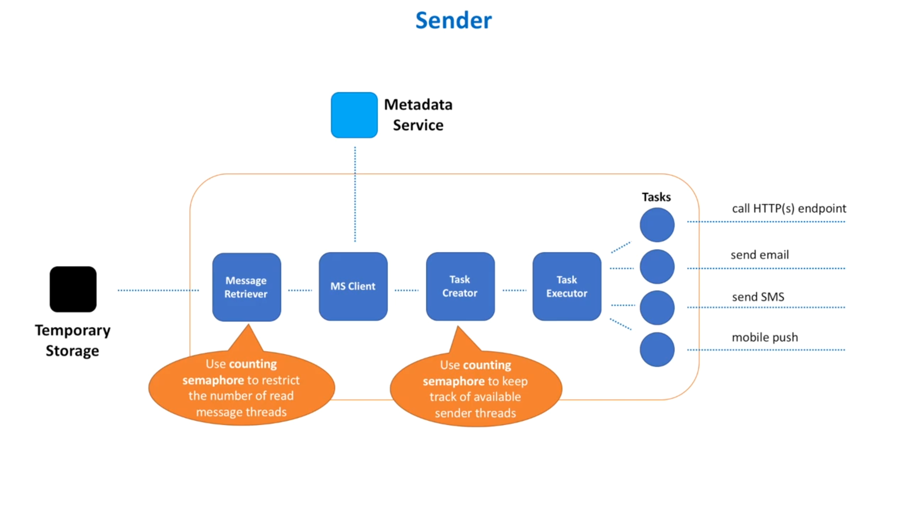

Slide 14
Message Retiever -
  The Sender first retrieves the message from the temp store using message retriever.
  The message retriever has a pool of threads which it uses to retrieve the messages.
  As a naive approach we can start with a predefined number of threads. But the problem comes if there is not many messages to retrieve then the ideal thread count increases. Also if there are many messages then all the threads in the pool are used up leaving sender service scaling the only option.
  A better approach can be an auto scaling approach where we keep track of ideal threads and adjust the total available threads dynamically. How can this be done? - Using counting semaphore.
  Conceptually semaphore maintians a list of permits. Before retrieving the next message a thread must acquire a permit from the semaphore. When the thread finishes reading the permit is returned to the semaphore. We can adjust the number of permits dynamically.

Slide 15
MS Client - After the message is retrieved, we need to contact the metadata service to fetch the subscriber info. Why do we need to make this call?
  We could have also passed the list of subscribers along with the message e.g. FS can get the list and pass it along with the message.But a problem with this approach is that the temp store needs to store all this information and if the list size is huge then we need more storage. In that case we might have to use document store instead of key-value/column store.
Now we can start sending the message to the list of subscribers. But how do we send them? What should we do if the message delivery failed for one subscriber? or what if one sunscriber is slow in processing the message causing an impact on the delivery to other subscribers?
  A better option is to split the message delivery into tasks where each task is responsible for delivery to a single subscriber. This way we can deliver messages in parallel and isolate any bad subscriber.

Slide 16
We introduce 2 new components - Task Creator and Task Executor
They are responsible for creating and scheduling single message delivery task.
Task creator -
  Create a pool of threads where each thread is responsible for executing a task. We can use counting semaphores to keep track of available threads in the pool.
Task executor -
  If we have enough threads for processing newly created tasks we submit tasks for processing. If we donot have enough threads then either pause/return the message to the temp store. A different sender host may pick up this message.
  Tasks may delegate the actual delivery to another microservice. ex- send mail service, send sms service.

Slide 17
What else?
Duplicate messages-
  The FS will eliminate the duplicate messages from producers. But retries from sender service due to subscriber unavailability or network failure, can cause duplicates in subscriber side. In this case the subscriber has to handle the duplicates.
Retry of the delivery attempt -
  Do we need retry? - Retries ensure at least once message delivery.
  To avoid retries, we can store the failed delivery messages into a system that can be monitored by the subscribers and subscribers then decide what to do with those undelivered messages.
Message Order-
  Our system doesnot guarantee FIFO because of the retires of delivery system.

Slide 18
Security -
  Only authenticated publishers can send message and registered subscribers can recieve messages.
  Encryption using SSL helps to secure the messages in transit.
Monitoring

